Slide 1
Team That needs to understand
Design Thinking
Devops : Devops is the culture for improvement

Slide 2
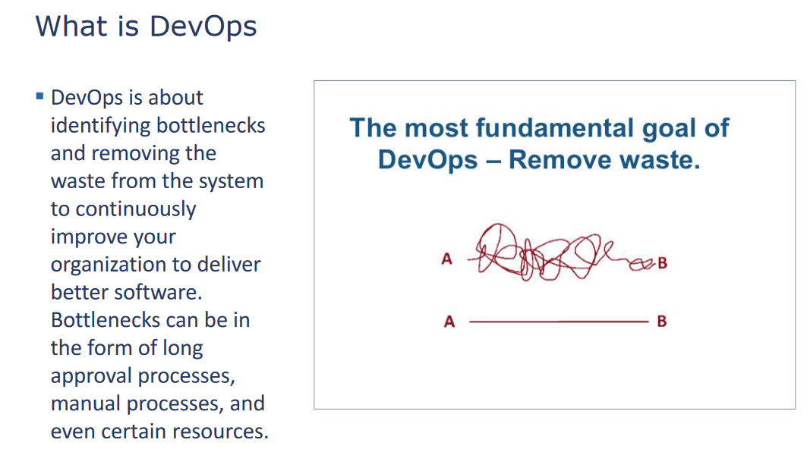

Slide 3
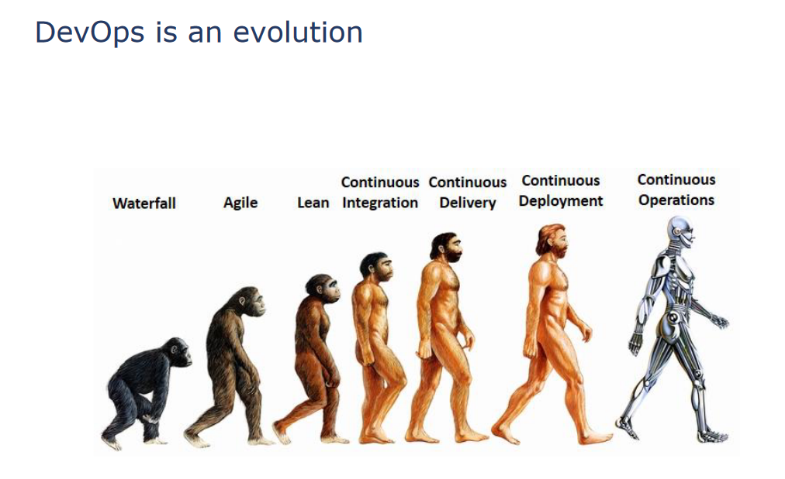

Slide 7
Conclusion from above case-study
1) Technology is changing/updating periodically
2) People are moving from older way to new way
3) Older technology are still exists, and still in use

Slide 8
How to implement any improvement?
We have 2 group of people who participates in this-
Development Group- They actually do the development
Operation Group- They support Development group

Slide 9
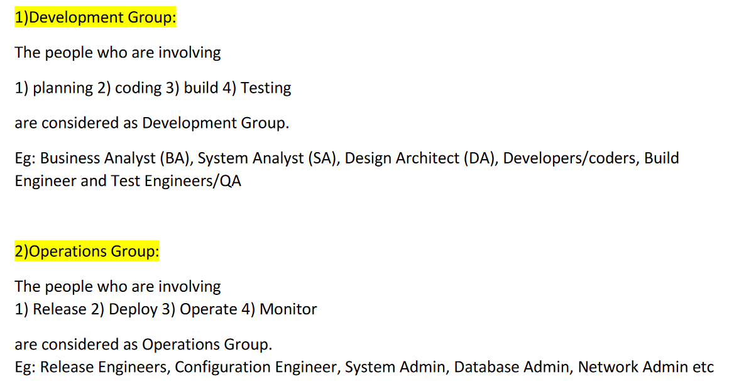

Slide 10
Developers develop
A developer is someone who writes and debugs code to create software and applications. Once an application is deployed in a production environment, the developer will generally monitor performance and gather feedback from users to implement changes and updates to make the software better. The goal of a developer is to continually create new applications and modify existing ones to make them better—effectively introducing change to the environment on a regular basis.

Slide 11
Operations operates
IT operations or IT admins have one objective: make sure everything is operating optimally. Operations ensures that network resources are available and functioning at peak performance. Once that equilibrium has been achieved, any new demands on the network resources threaten the stability of the environment and require operations to invest time and effort to make sure they're still performing as expected.

Slide 12
The culture clash
Ultimately, both developers and operations are striving for the same thing: to make the organization as productive as possible. In spite of their similar objectives, though, it's easy to see how these conflicting roles can get in the way of each other. Developers are trying to create and improve applications as quickly as possible, and operations is doing everything it can to prevent changes from occurring in the environment. Something has to give in order for the organization to function effectively and efficiently.

Slide 13
How develops are operators are seeing a problem?

Slide 14
Devops Principle
1. Treat Ops as first-class citizens from the point of view of requirements. Adding requirements to a system from Ops may require some architectural modification. In particular, the Ops requirements are likely to be in the area of logging, monitoring, and information to support incident handling.
2. Make Dev more responsible for relevant incident handling. By itself, this change is just a process change and should require no architectural modifications. However, just as with the previous category, once Dev becomes aware of the requirements for incident handling, some architectural modifications may result.
3. Enforce deployment process used by all, including Dev and Ops personnel. In general, when a process becomes enforced, some individuals may be required to change their normal operating procedures and, possibly, the structure of the systems on which they work. One point where a deployment process could be enforced is in the initiation phase of each system. Each system, when it is initialized, verifies its pedigree. That is, it arrived at execution through a series of steps, each of which can be checked to have occurred. Furthermore, the systems on which it depends (e.g., operating systems or middleware) also have verifiable pedigrees.
4. Use continuous deployment. Continuous deployment is the practice that leads to the most far- reaching architectural modifications. On the one hand, an organization can introduce continuous deployment practices with no major architectural changes.
5. Develop infrastructure code with the same set of practices as application code. These practices will not affect the application code but may affect the architecture of the infrastructure code

